Slide 1
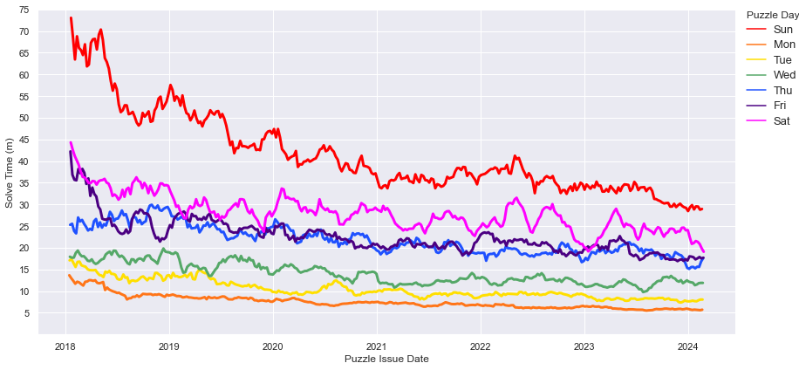
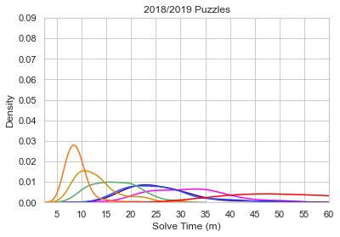
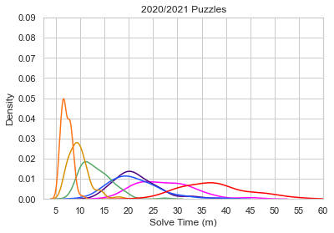
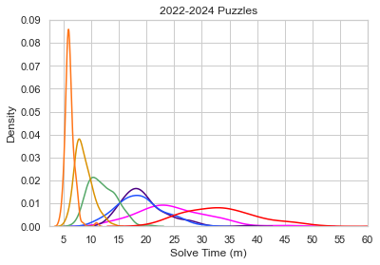
Notes:
Fig. 3

Slide 2
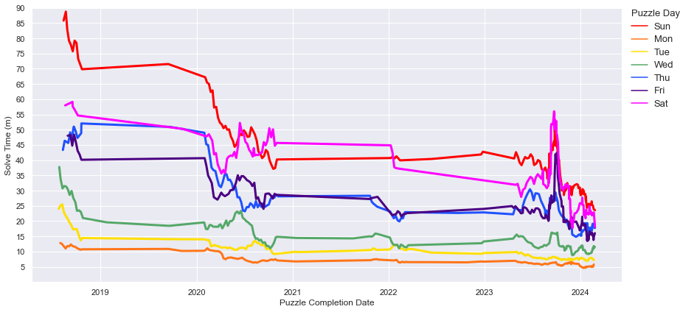
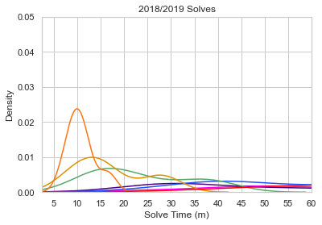
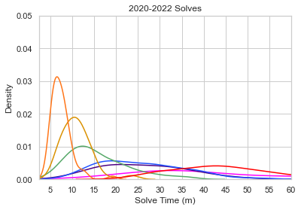
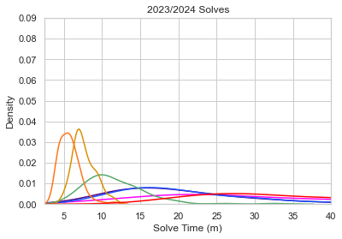
Notes:
Fig. 2

Slide 3
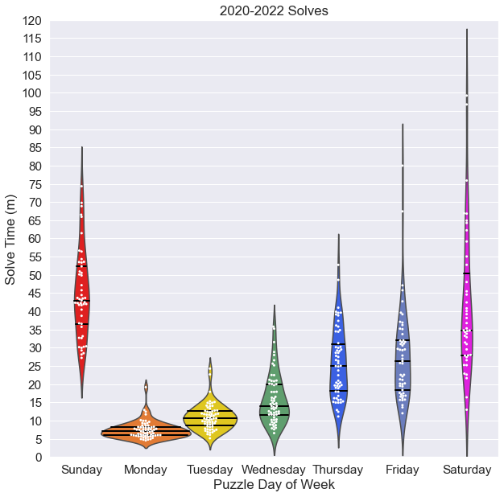
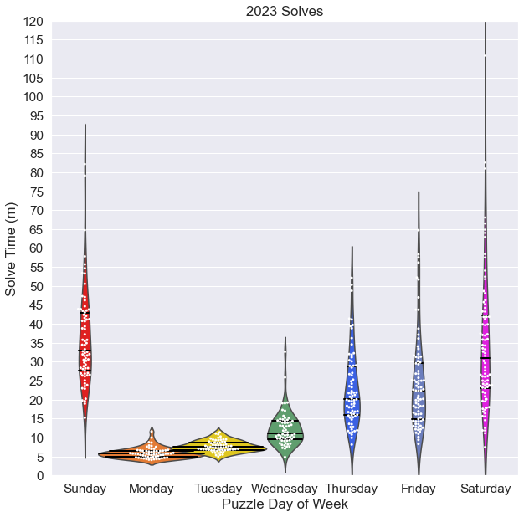
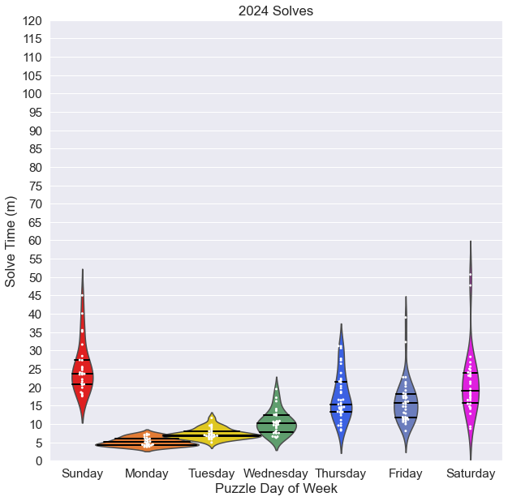
Notes:
Fig. 3 live versions

Slide 4
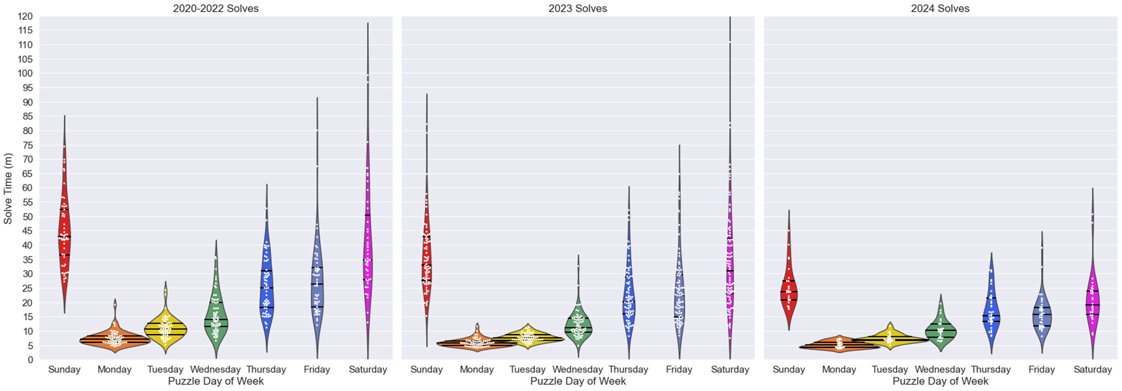
Notes:
Fig. 3 flattened version

Slide 5
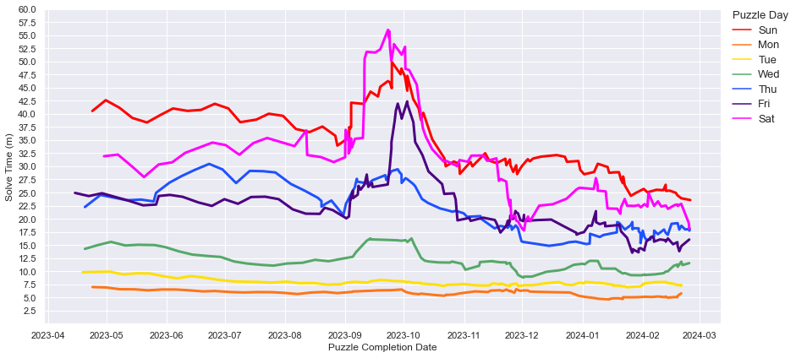
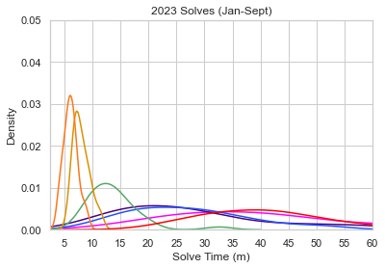
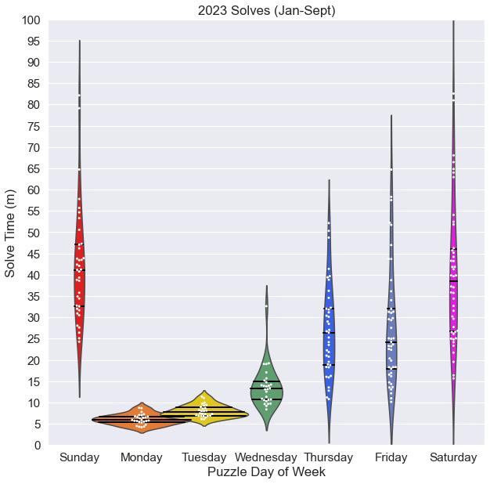
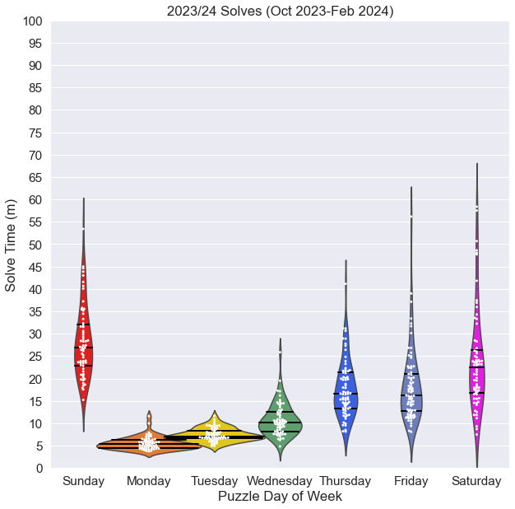
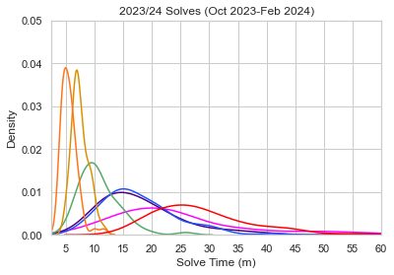
Notes:
Fig. 4 split interval

Slide 6
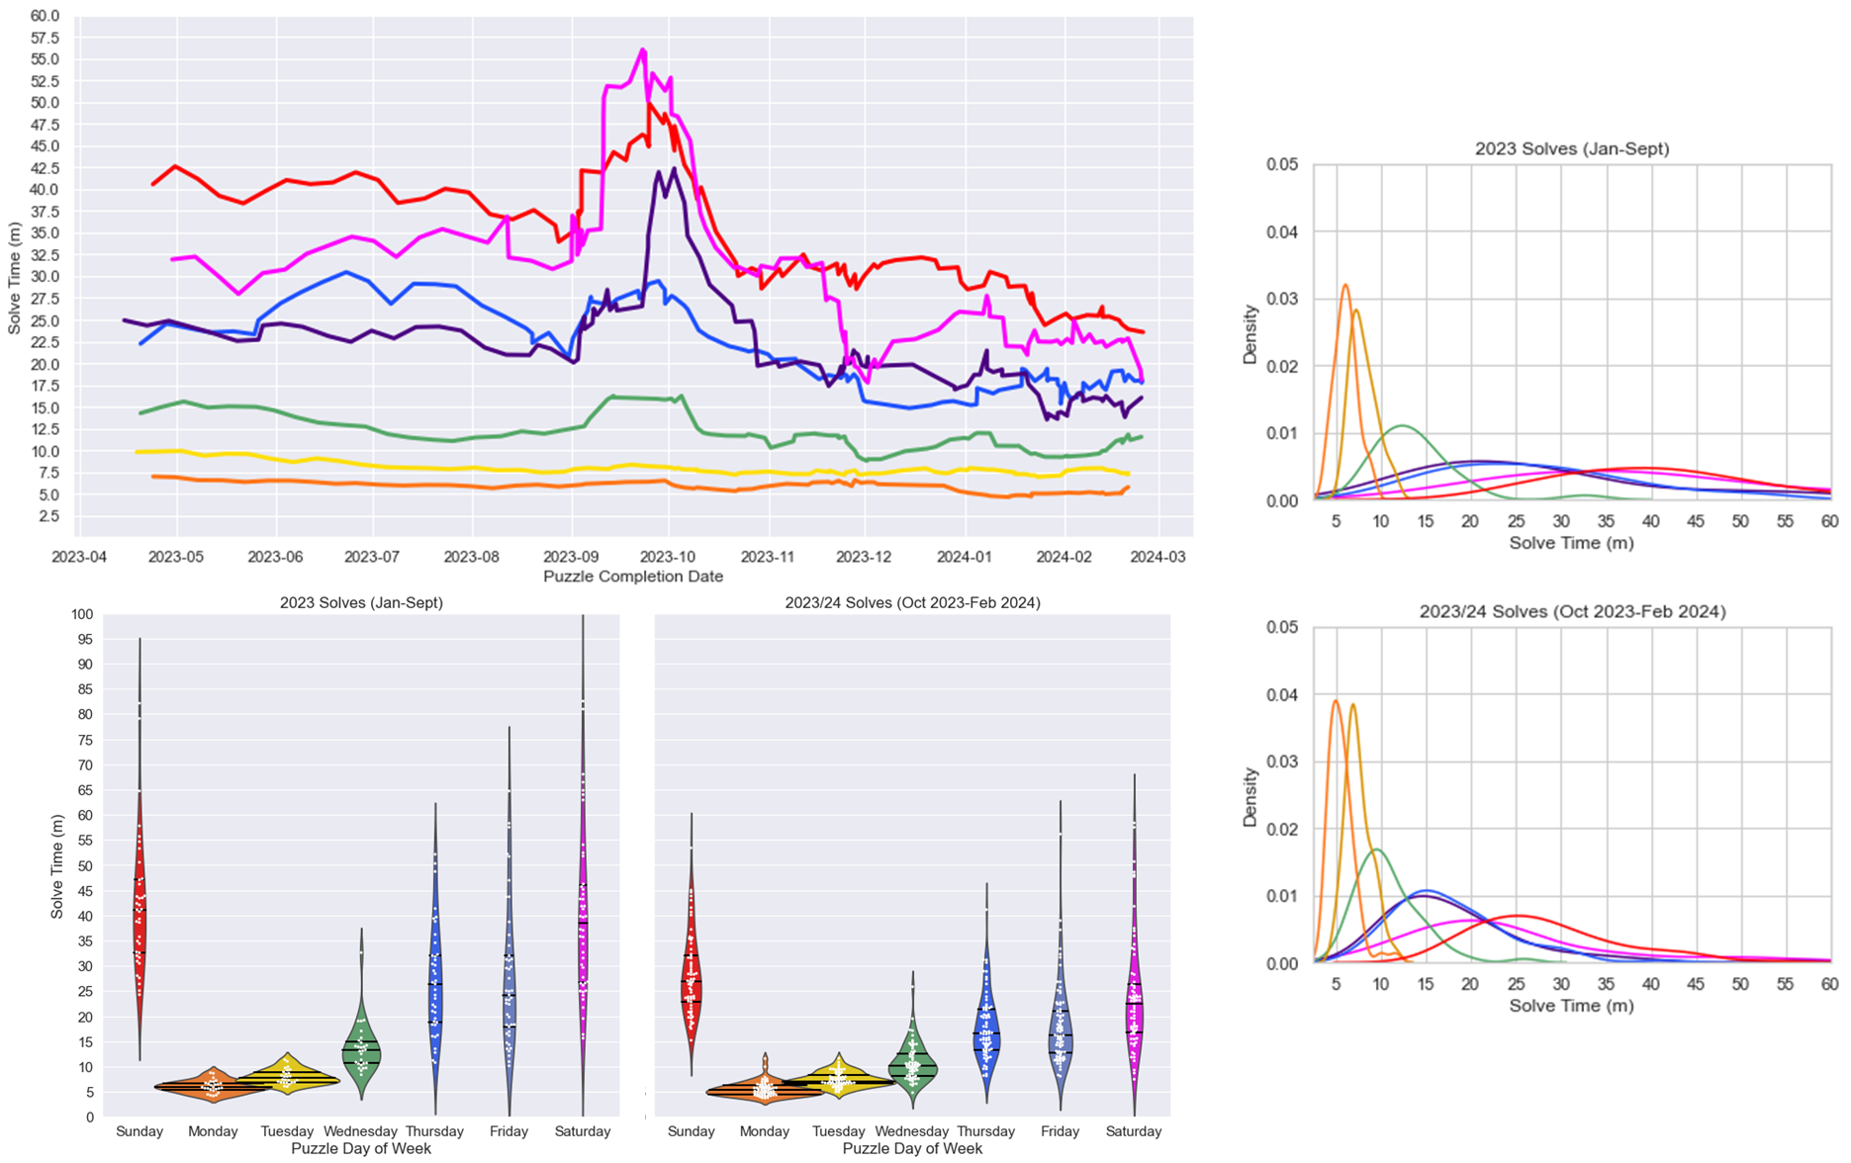

Slide 7
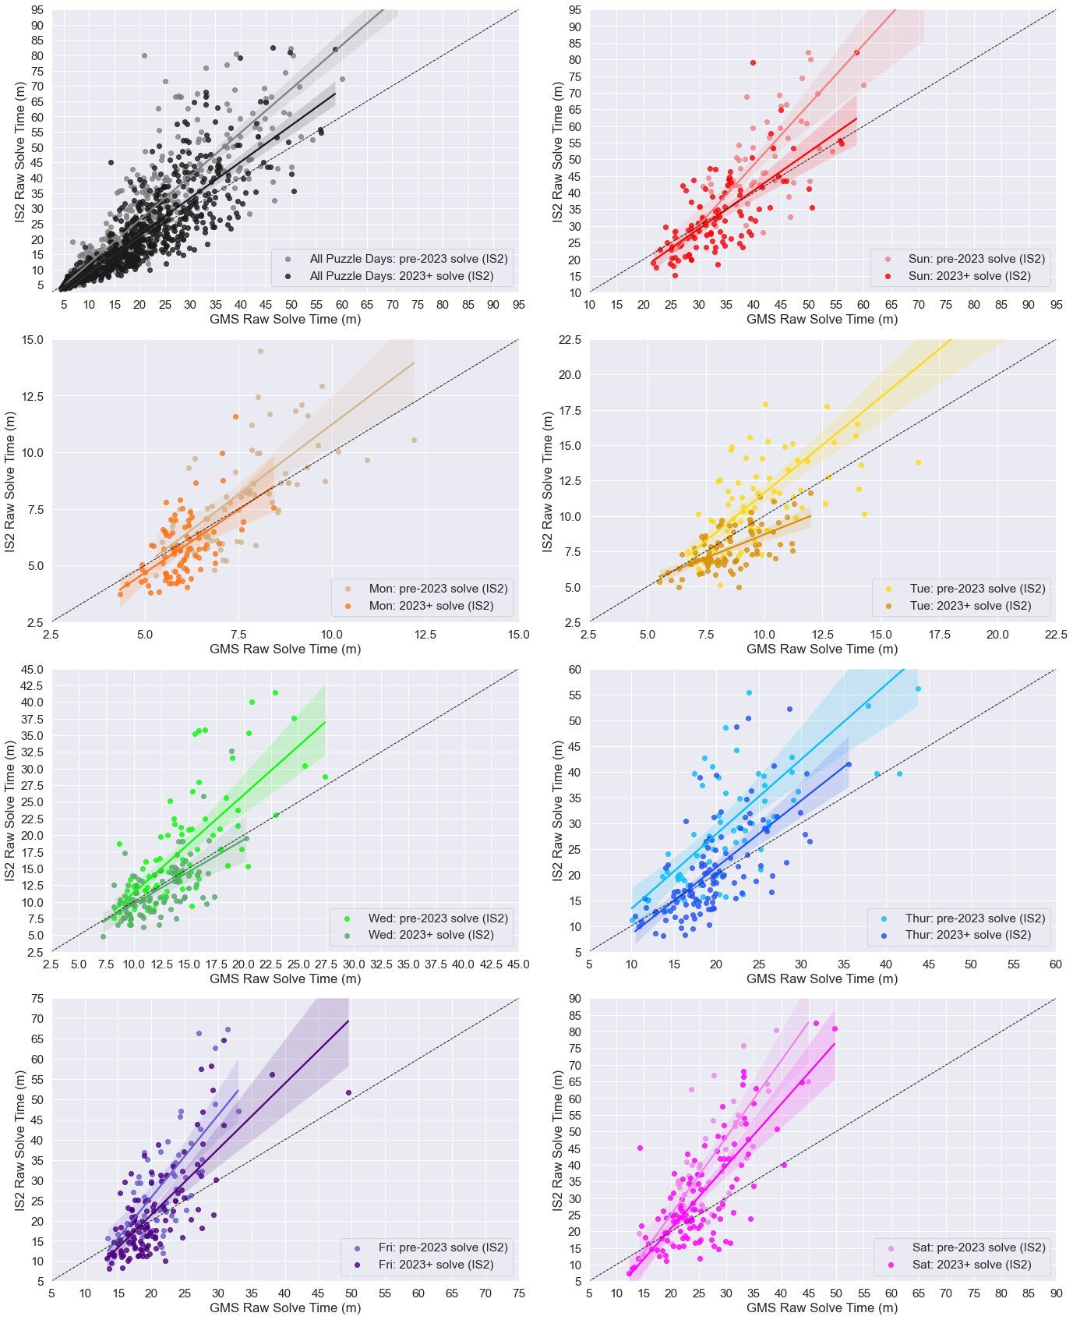
Notes:
Fig 5

Slide 8
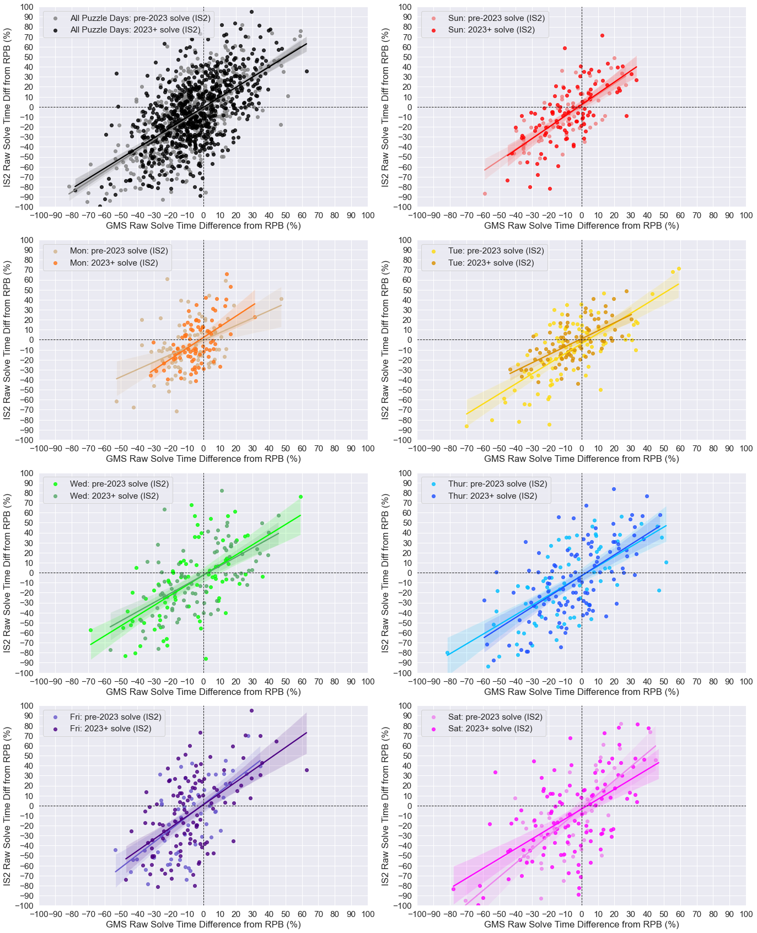
Notes:
Fig 6

Slide 9
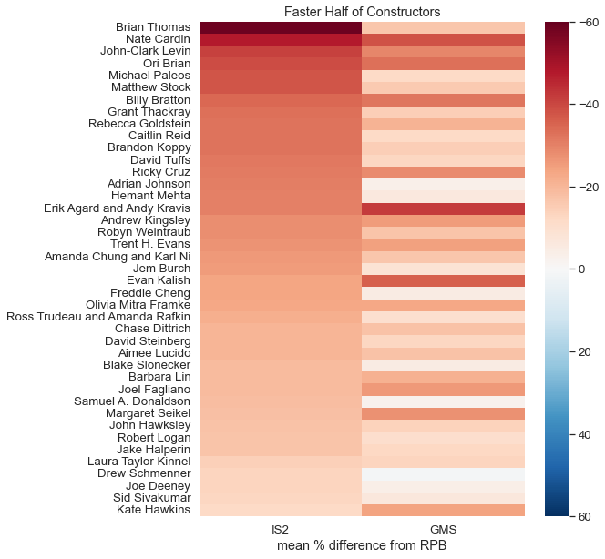
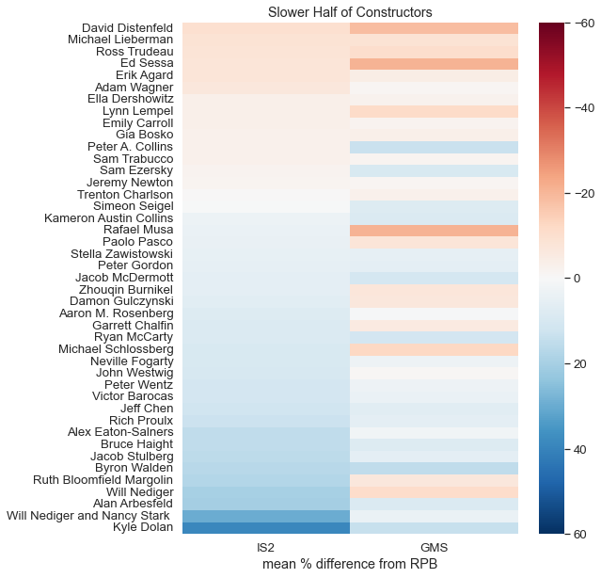
Notes:
Figure 7 live

Slide 10
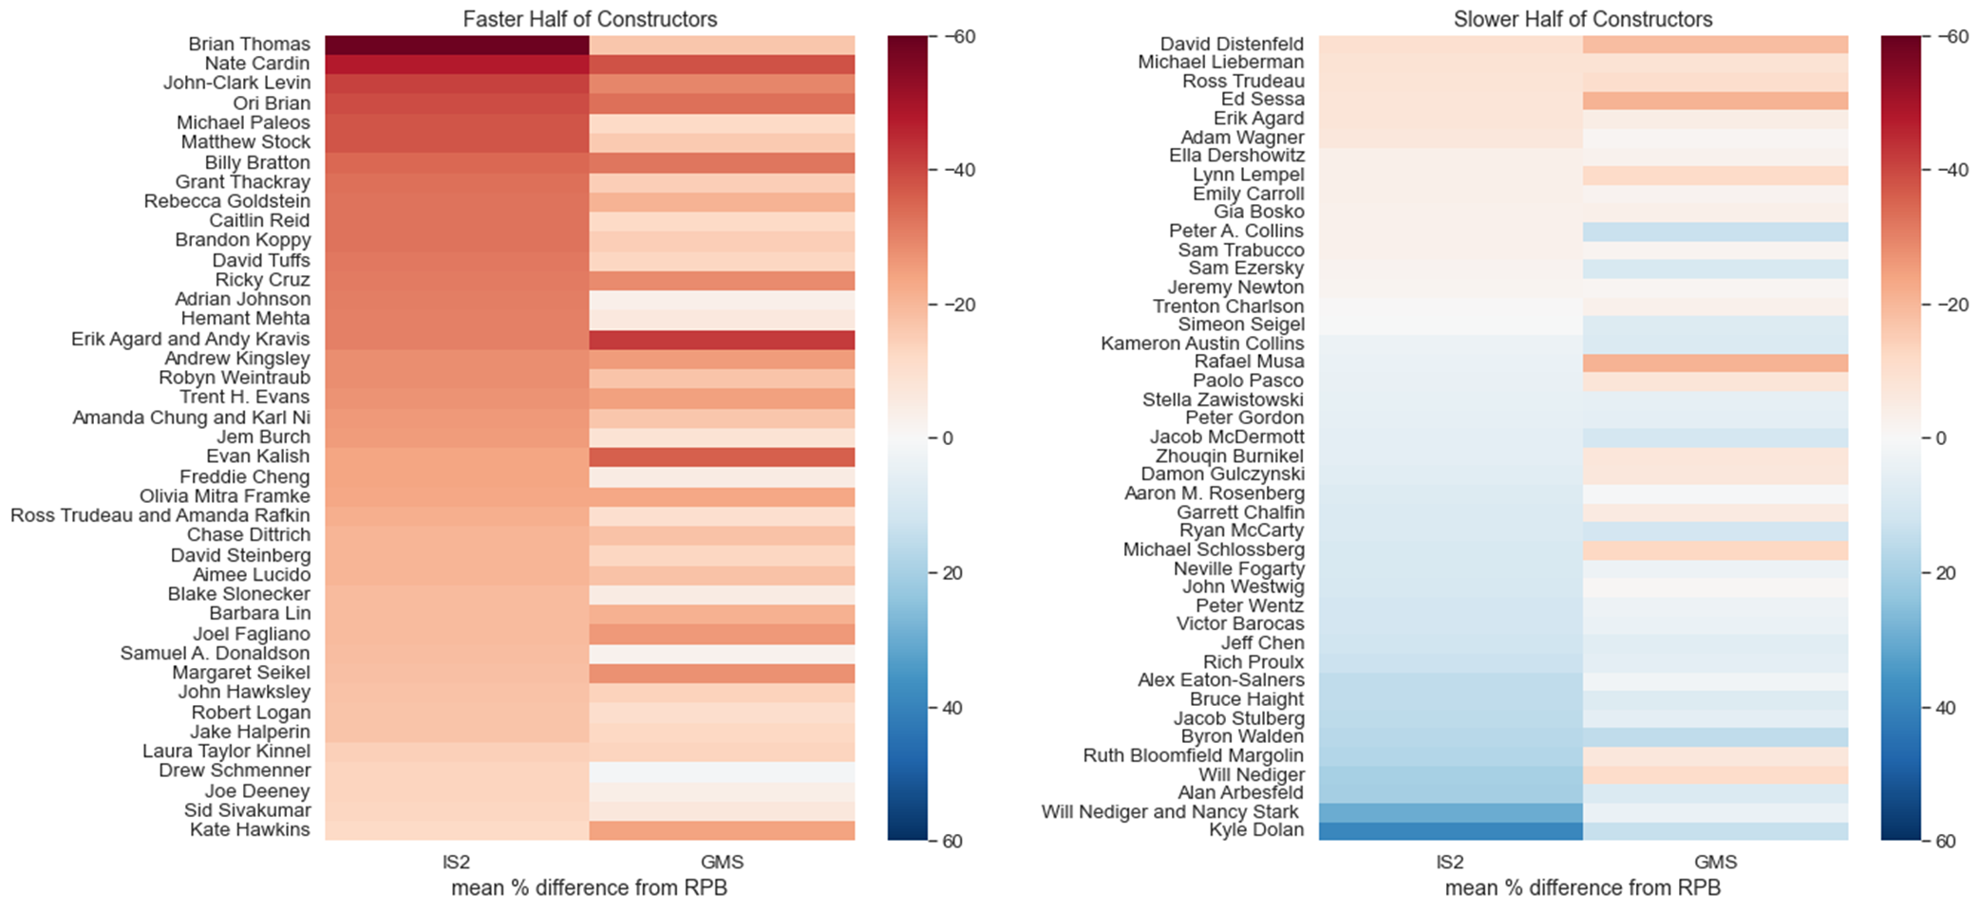
Notes:
Fig 7 flat

Slide 11
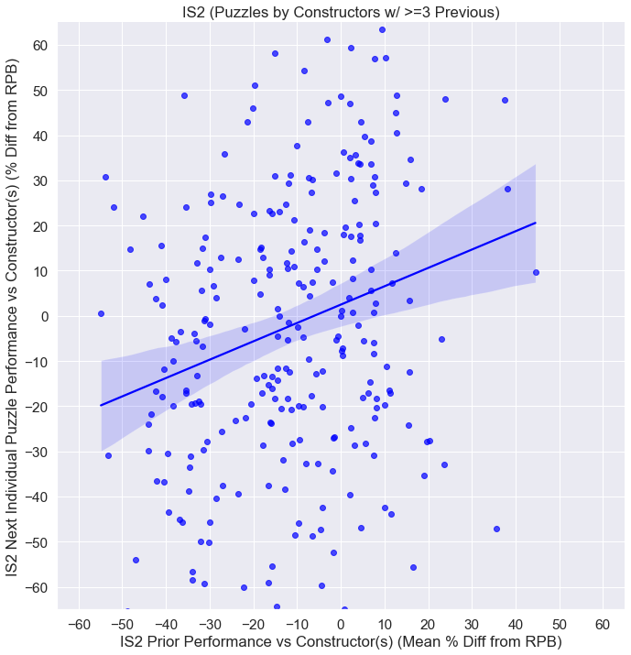
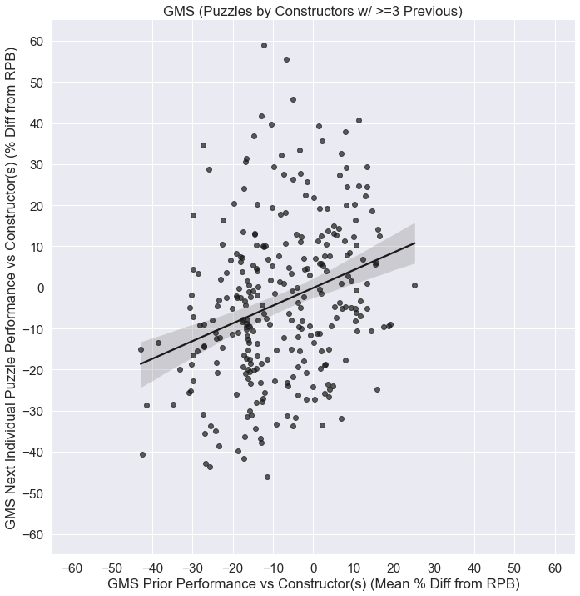
Notes:
Figure 8

Slide 12
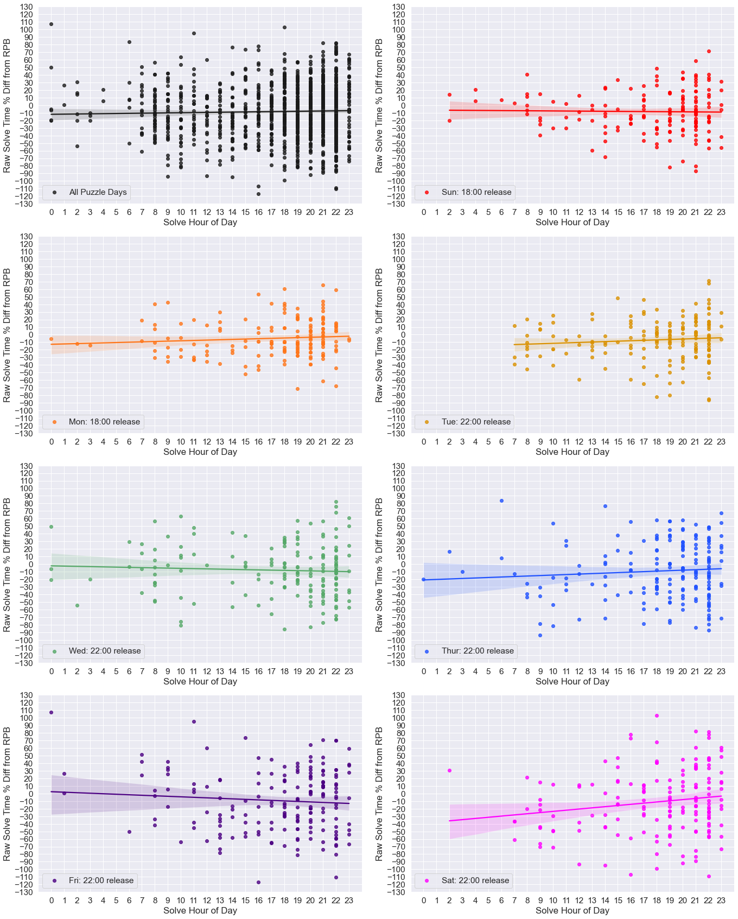
Notes:
Figure 9

Slide 13
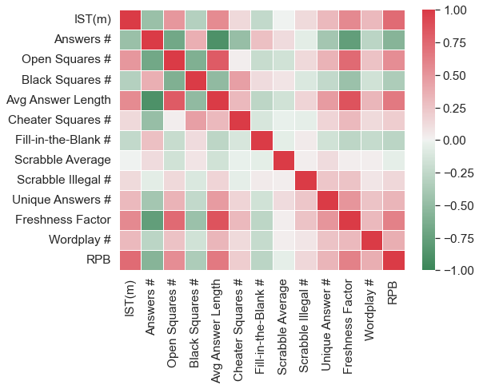
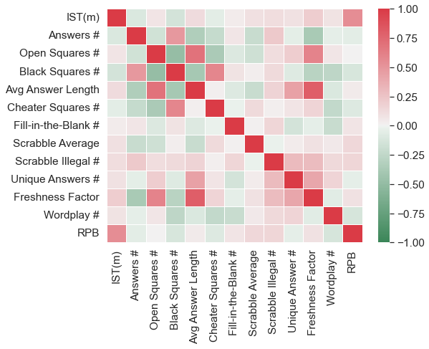
15x15 Puzzles (Mon-Sat)
21x21 Puzzles (Sun)
Clue/Answer
Content
Past
Results
Clue/Answer
Content
Past
Results
Grid Features
Grid Features
Notes:
Figure 10

Slide 14
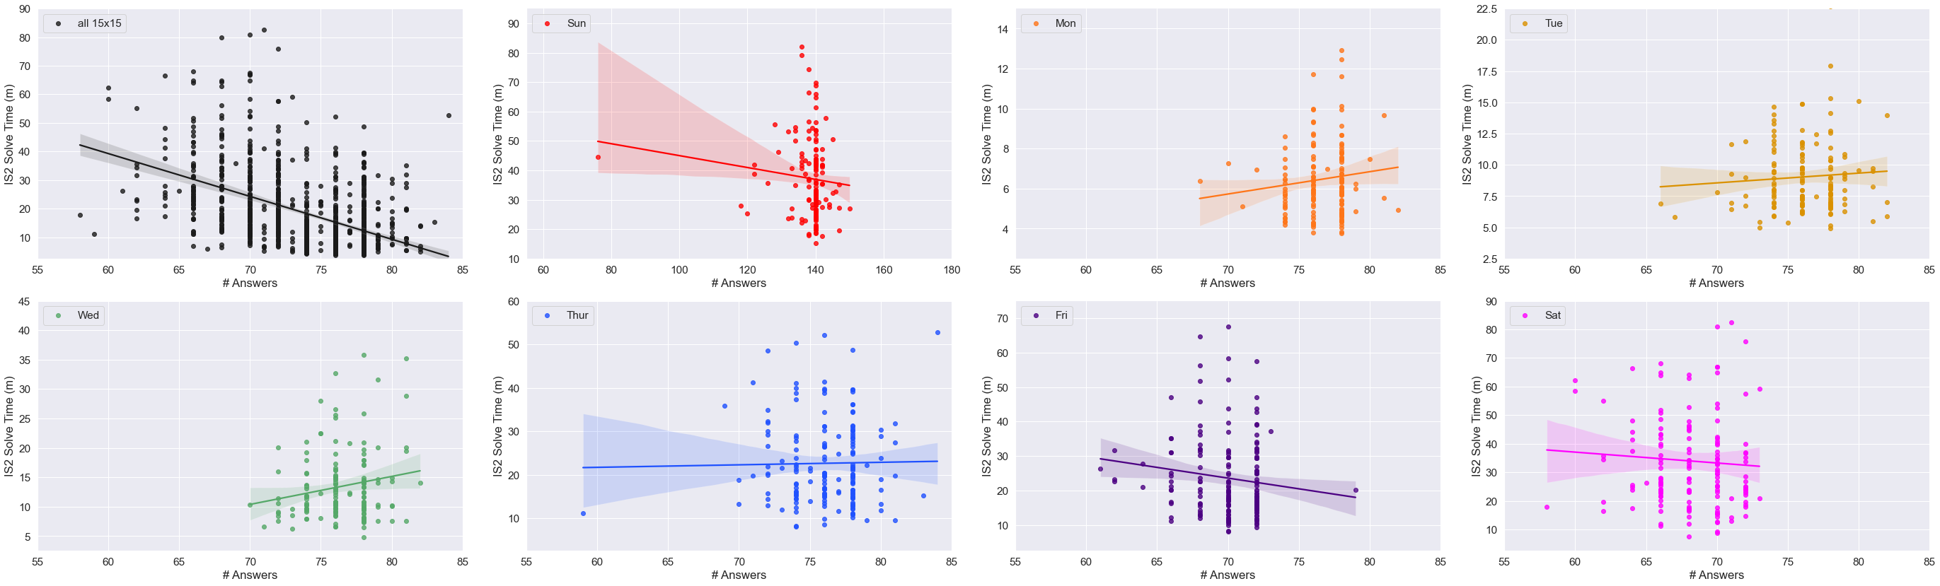
Notes:
Figure 11

Slide 15
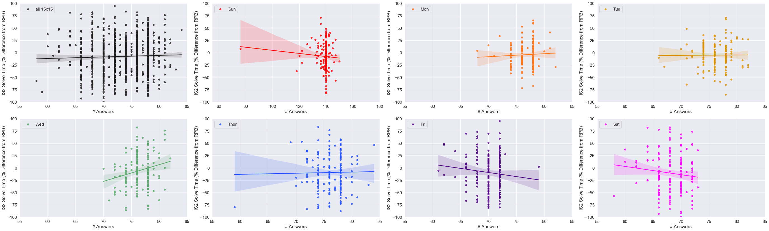
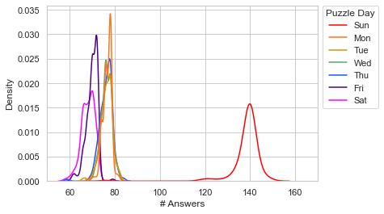
Notes:
Figure 11

Slide 16
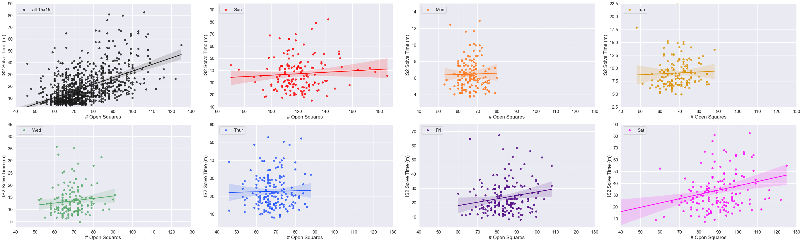
Notes:
Figure 12

Slide 17
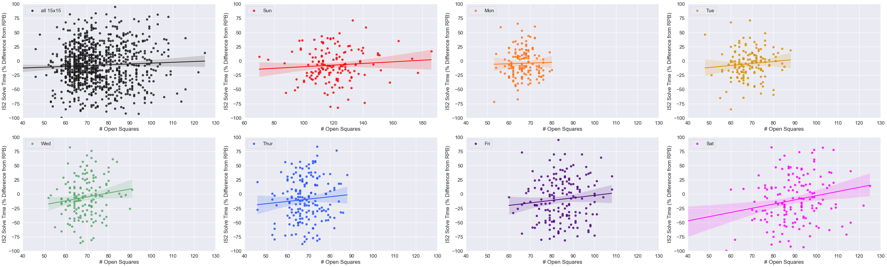
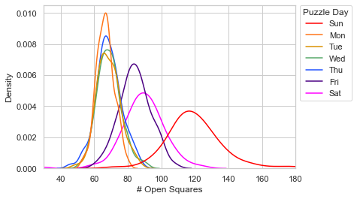
Notes:
Figure 12

Slide 18
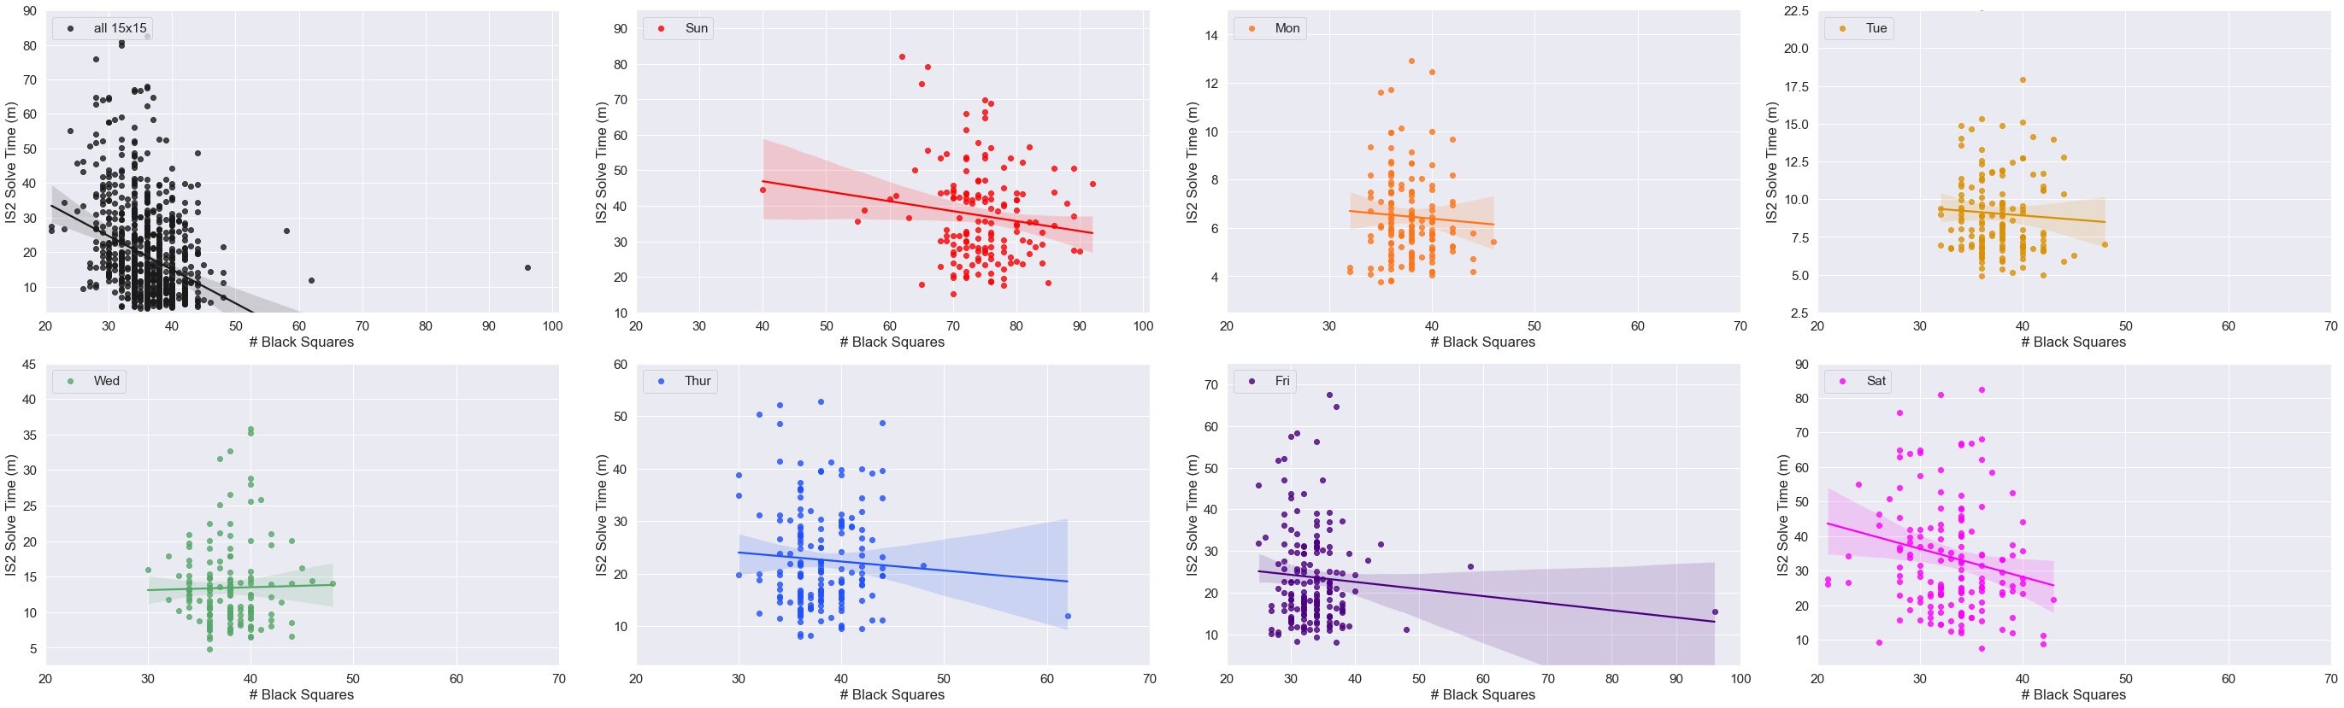
Notes:
Figure 12

Slide 19
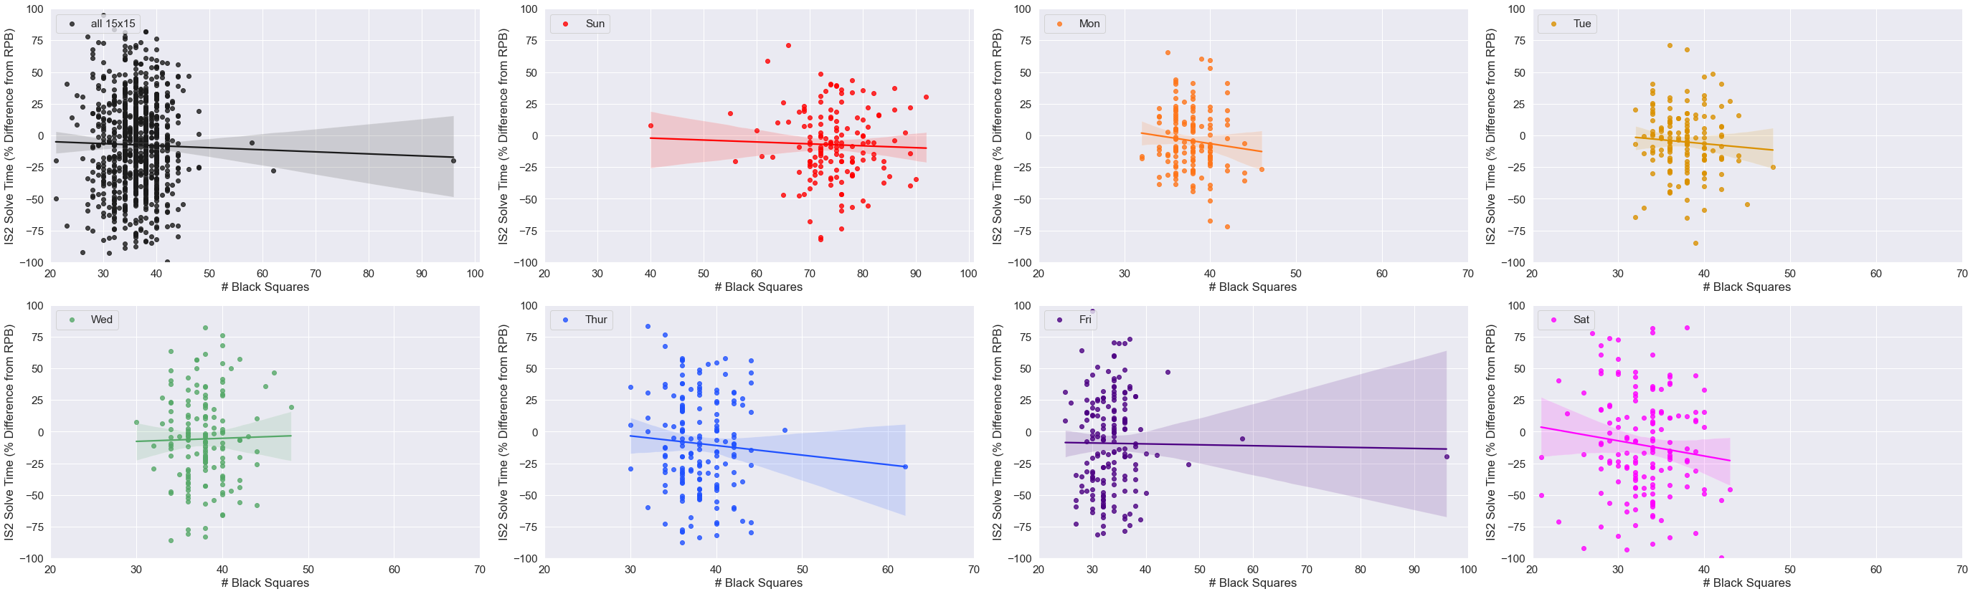
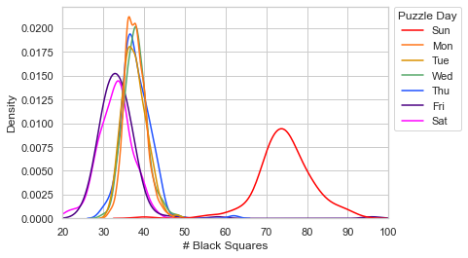
Notes:
Figure 12

Slide 20
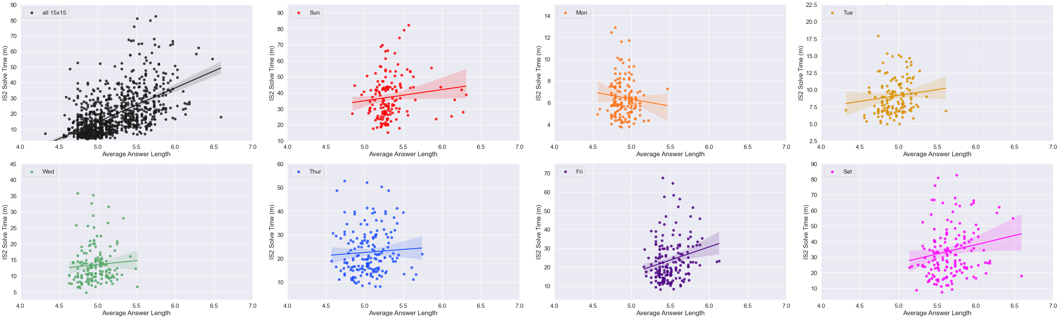
Notes:
Figure 13

Slide 21
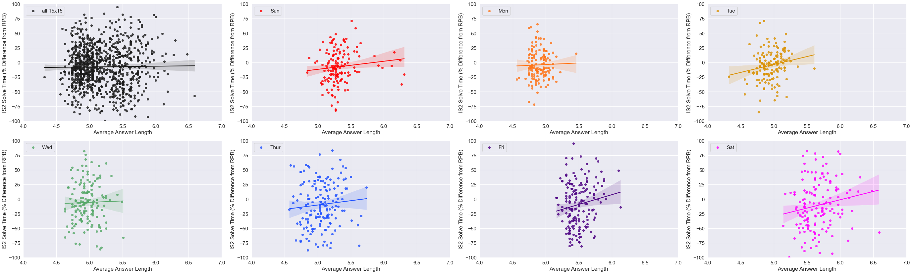
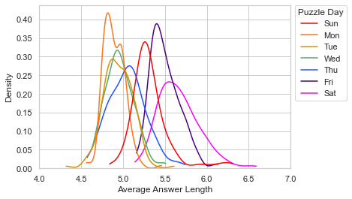
Notes:
Figure 13

Slide 22
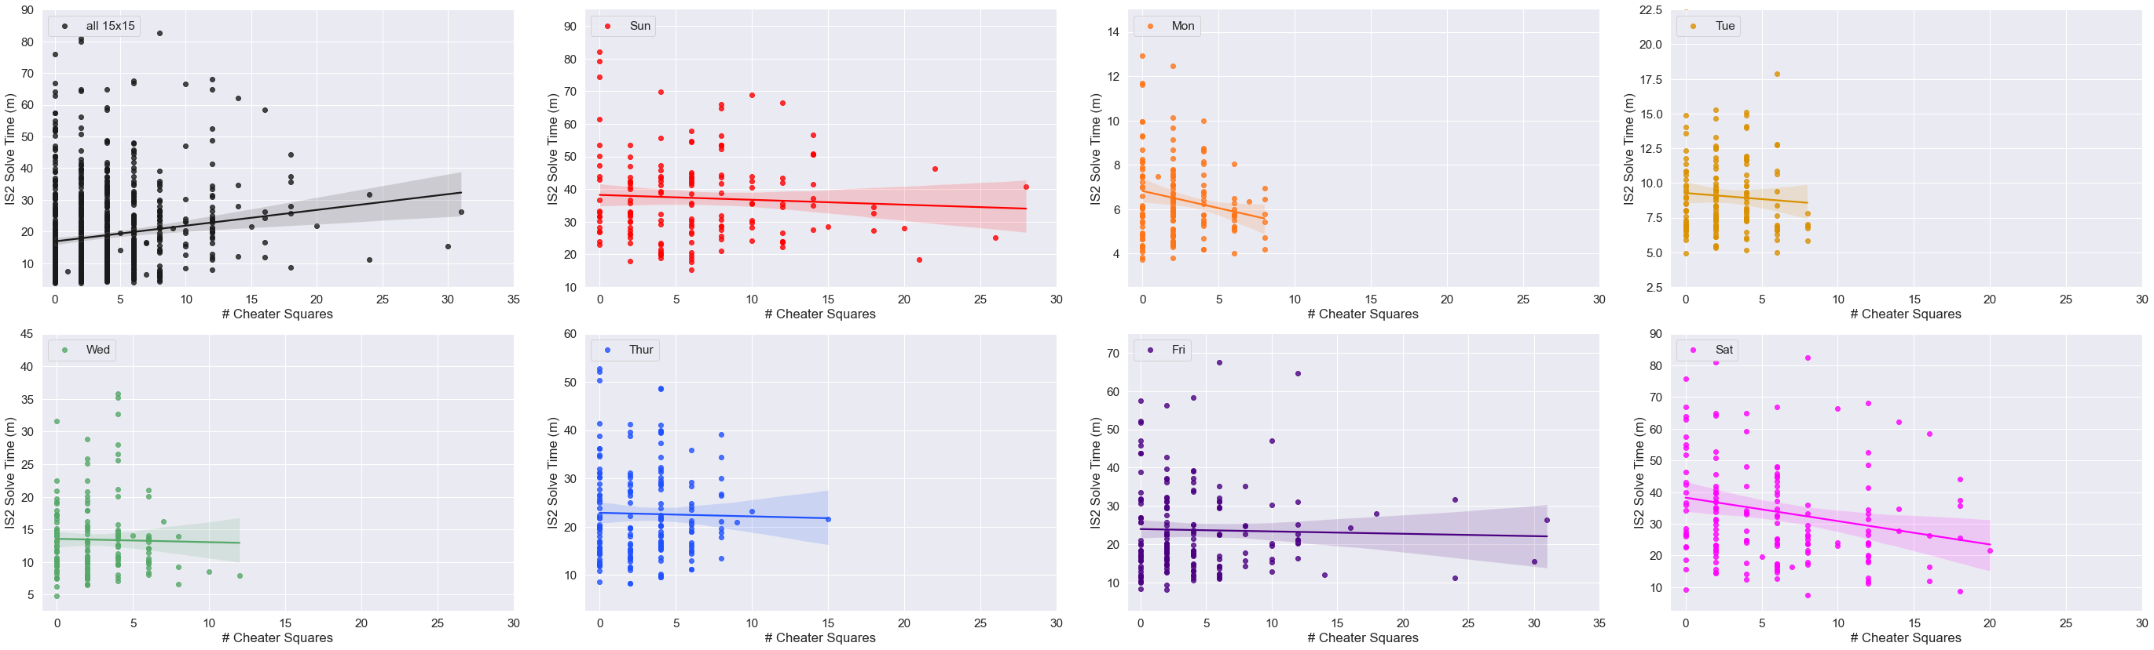
Notes:
Figure 14

Slide 23
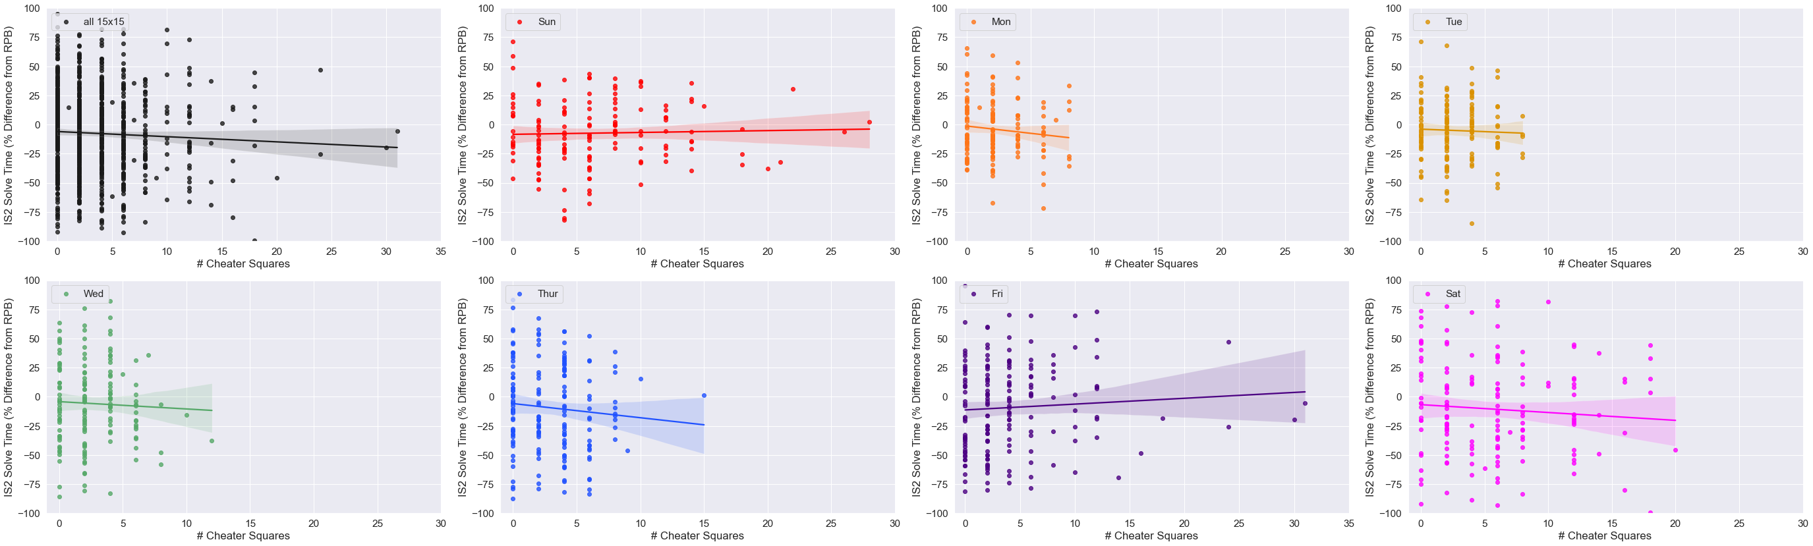
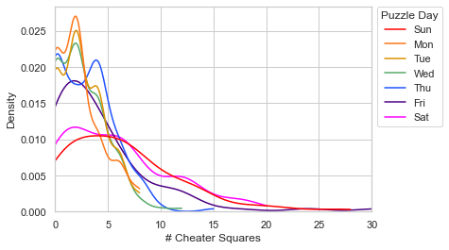
Notes:
Figure 14

Slide 24
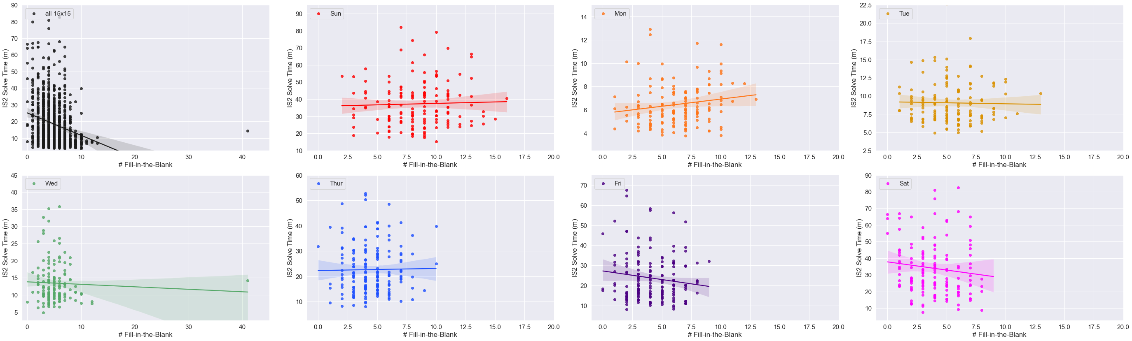
Notes:
Figure 16

Slide 25
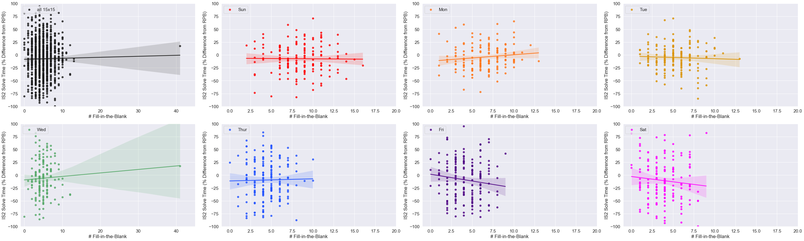
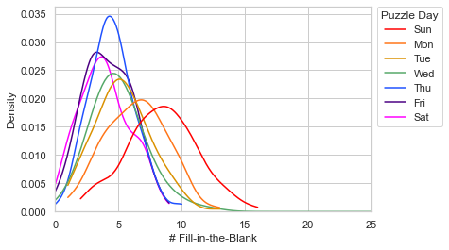
Notes:
Figure 16

Slide 26
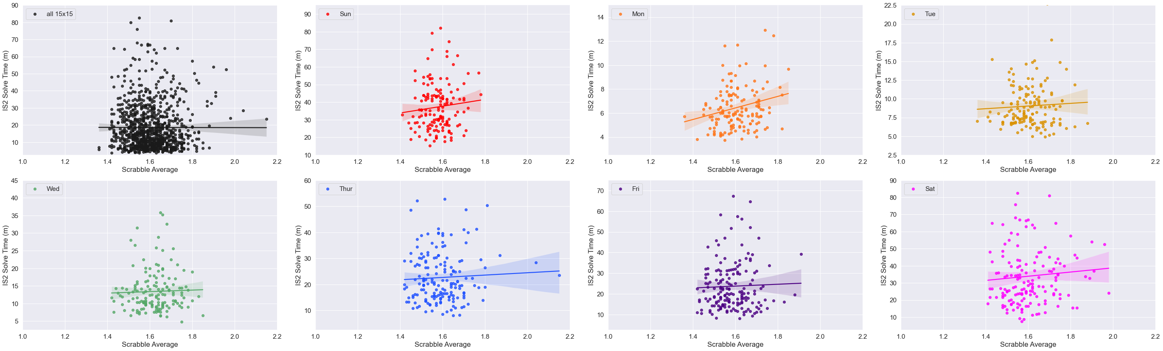
Notes:
Fig. 17

Slide 27
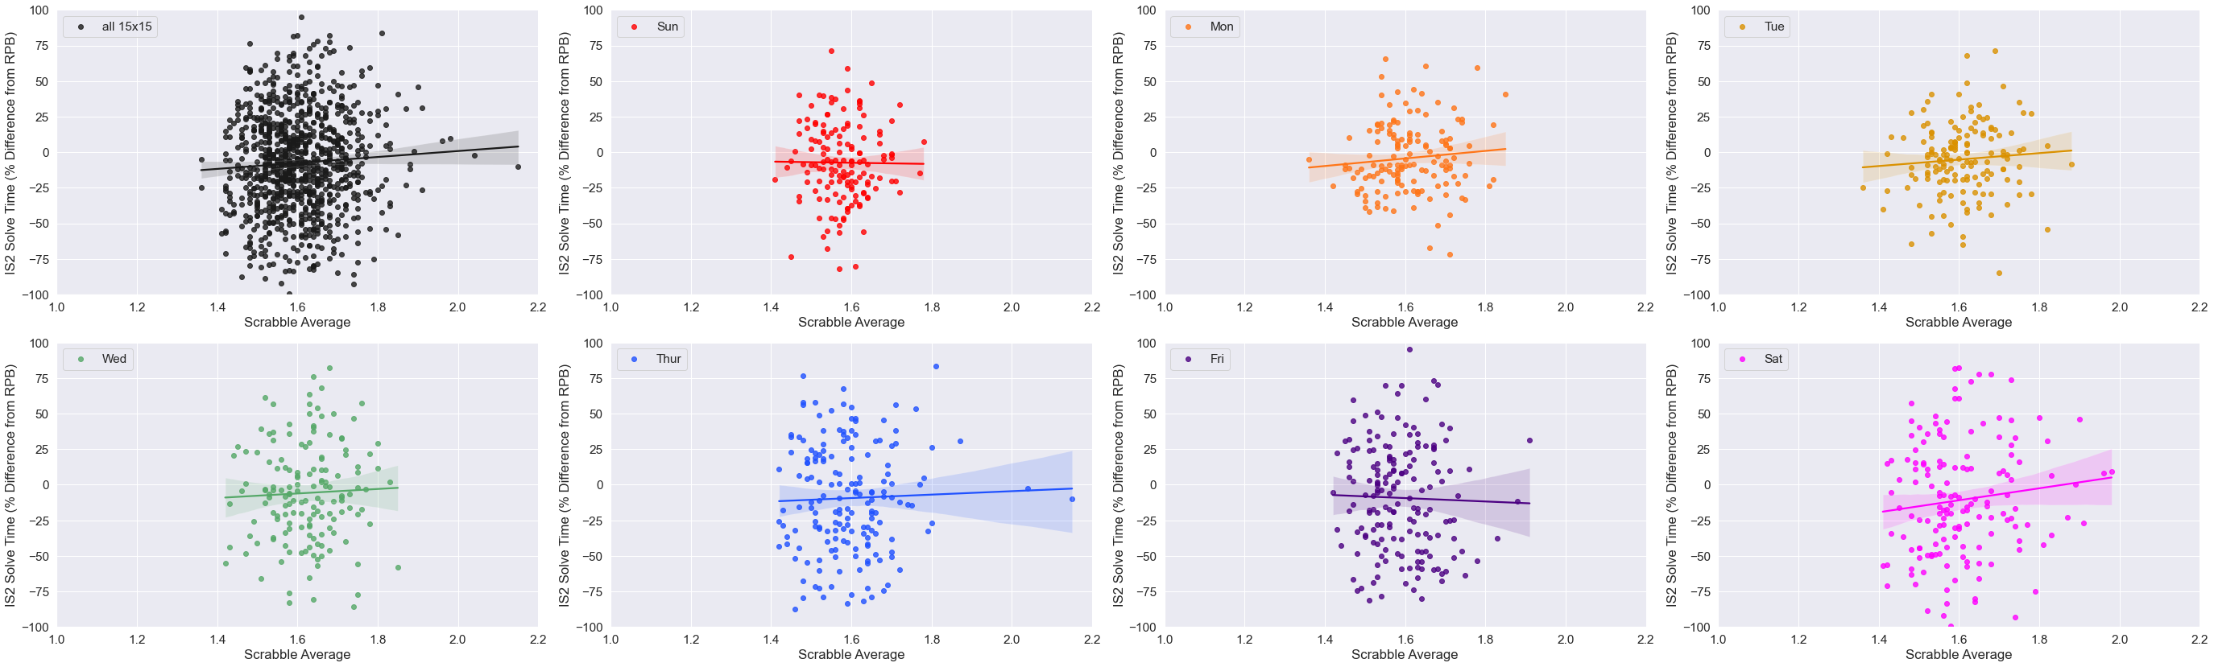
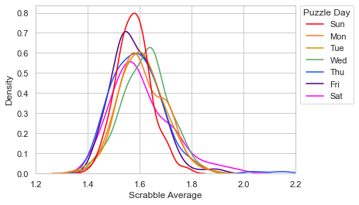
Notes:
Fig. 17

Slide 28
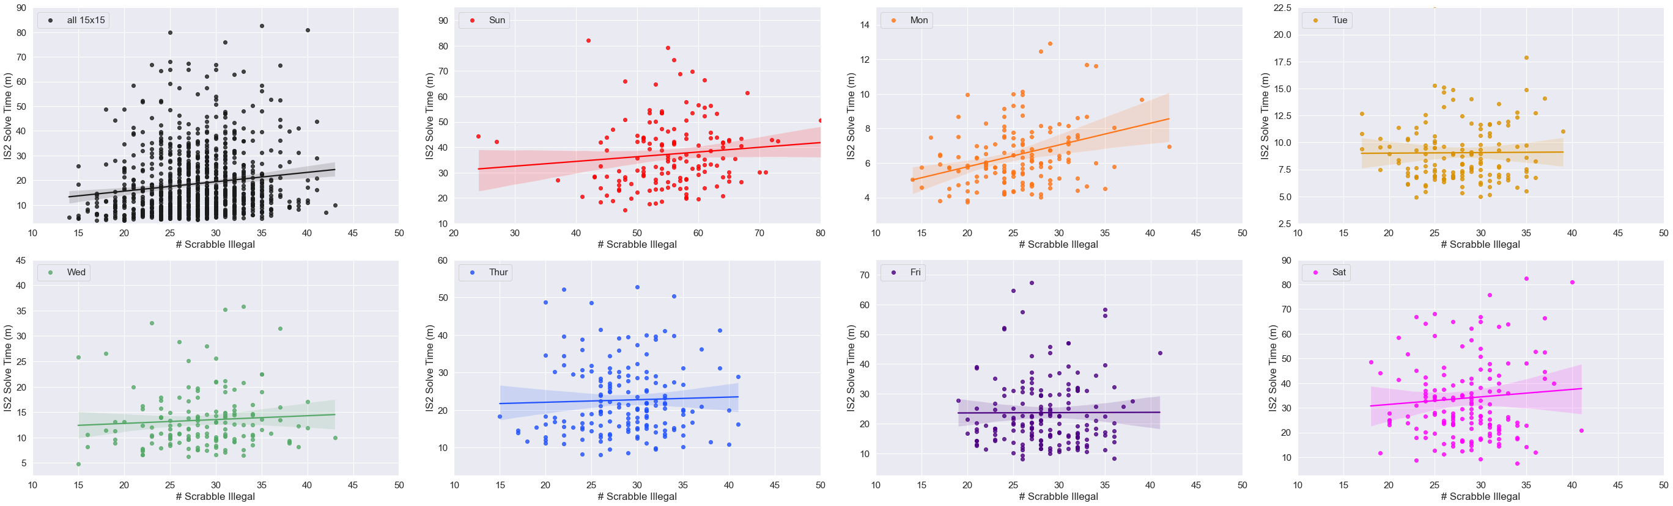
Notes:
Fig. 18

Slide 29


Notes:
Fig. 18

Slide 30

Notes:
Fig. 19

Slide 31


Notes:
Fig. 19

Slide 32

Notes:
Fig. 20

Slide 33


Notes:
Fig. 20

Slide 34

Notes:
Fig. 21

Slide 35


Notes:
Fig. 21

Slide 36

Notes:
Fig. 22

Slide 37
Data Supplement

Slide 38

Notes:
Supplementary Figure 1

Slide 39

Notes:
Supp. Fig. 2

Slide 40






Monday
Tuesday
Wednesday
Thursday
Friday
Saturday
Notes:
Supp. Fig. 3 live version

Slide 41


Notes:
Supp. Fig. 3 flat version

Slide 42

Notes:
Supplementary Figure 4

Slide 43

Notes:
Supplementary Figure 4

Slide 44

Notes:
Supplementary Figure 3

Slide 45

Notes:
Supplementary Figure 3

Slide 46

Notes:
Supplementary Figure 4

Slide 47

Notes:
Supplementary Figure 4

